Slide 1
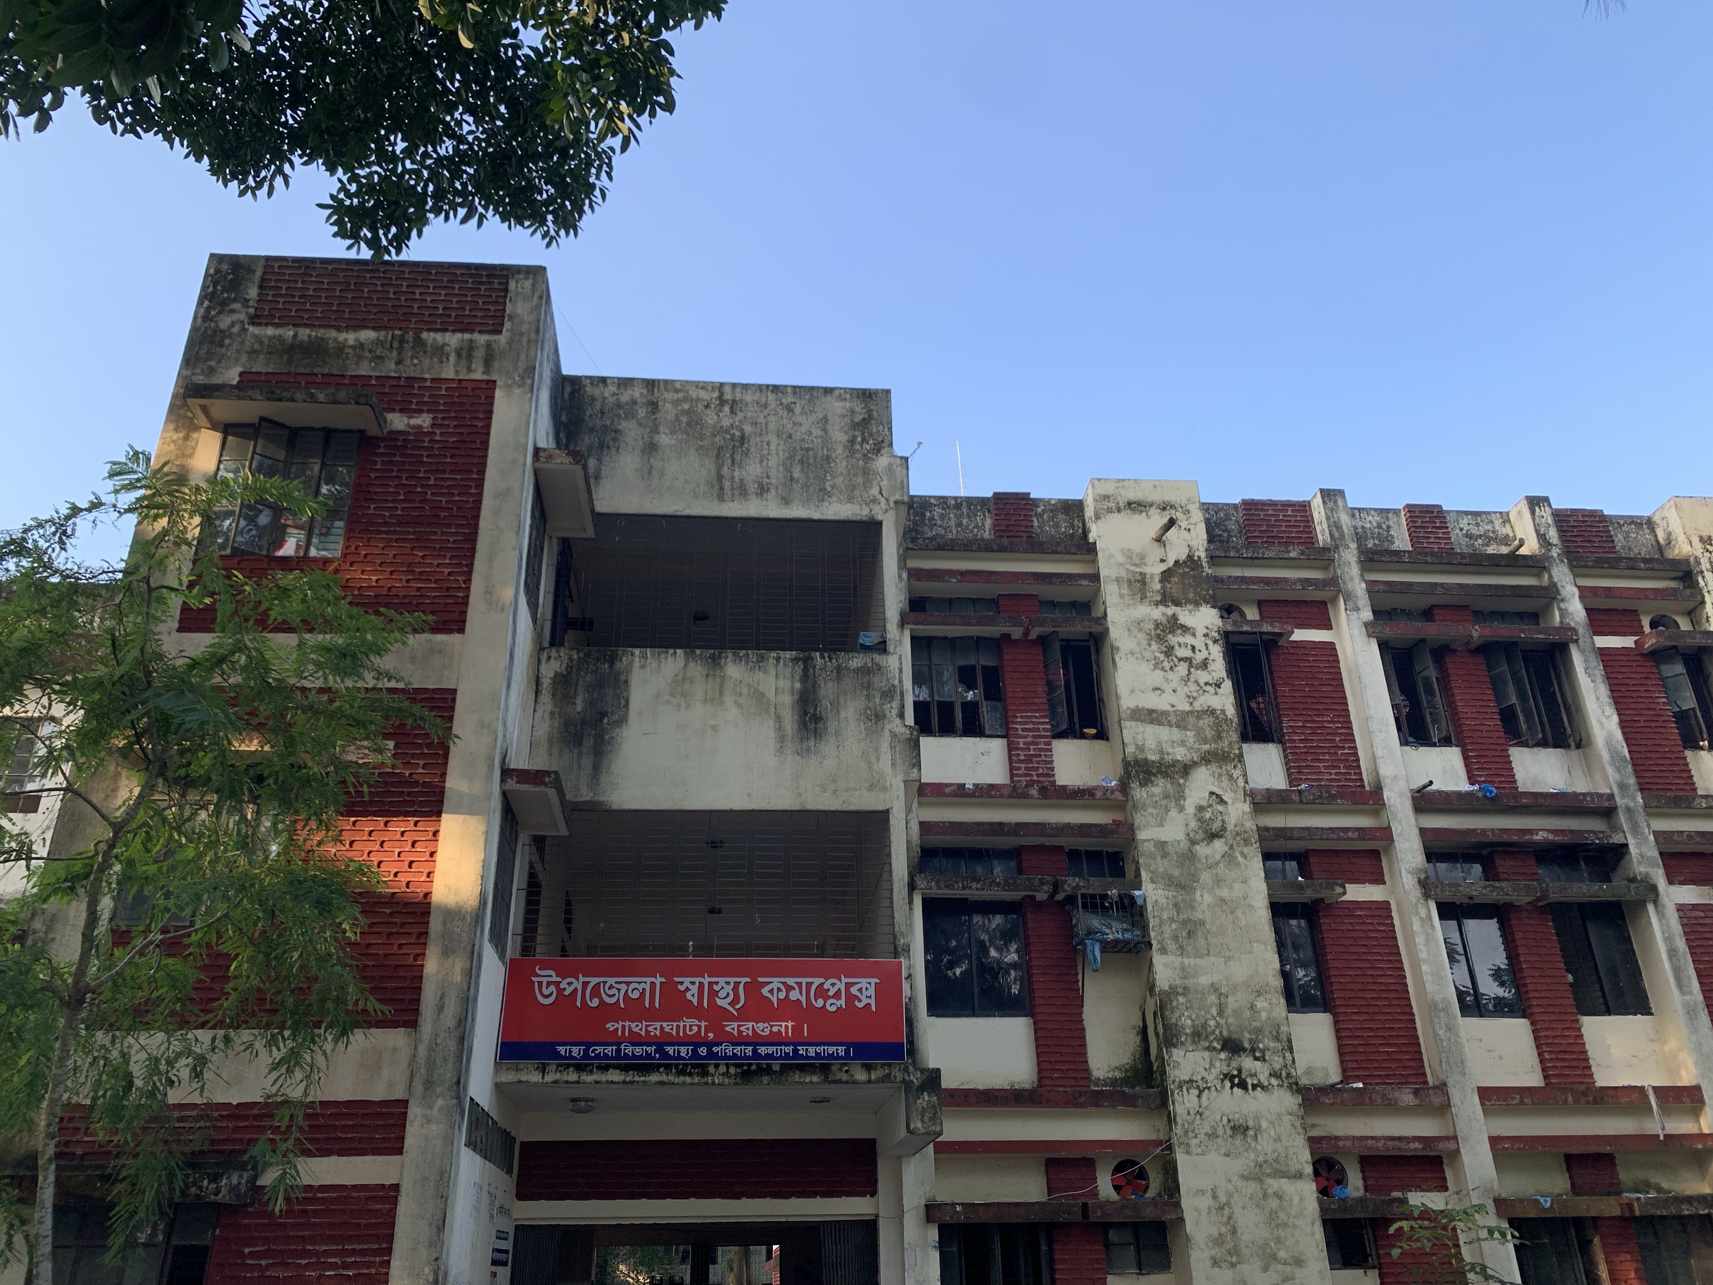
50 BEDDED UPAZILLA HEALTH COMPLEX
Patharghata, Barguna.

Slide 2
A Sub-district level Hospital with a Vision
Maximum utilization of Govt.
resources with
honesty and sincerity
Integrated approach of
Administration, Community
Leaders & Health
Management
Providing Effective and
prompt services
through improved
management system

Slide 3
Background History of the Patharghata UHC
As example:
In 1977, the hospital started as Thana Health Complex, Madhupur.
The health complex was declared as Upazilla Health Complex 1982.
It was upgraded to 31 bedded hospital in 2008.
C-section started in ……
SSK program was started in 2022.
The health complex is upgraded to 50 bedded hospital in 15 October 2020.
From 1 July 2020, the UHC started the service delivery system as 100 bedded hospital.
NCD corner started in 2022

Slide 4
Health Profile of Patharghata Upazilla(2017-2022)
Total population : 193744
Total Pregnant : 3874
Total Live birth : 3770
Total death : 754
Total Maternal death : 07
Health Man power
a. Doctor : 17 ( 12 + 5)
b. Nurse : 36 (33+3)
c. HA : 32
e. Volunteer, Security guard & cleaner: 5
7. Health Institutions
a. Health Complex : 01
b. H & FWC : 6 (RD- 1 + FWC– 5 )
c. Community clinic : 21
d. Non-Govt. Clinic : 08

Slide 5
10. Mother Taken-ANC : 325 ( 1st Visit)
11. Hospital Delivery Rate : 15.4 (338)
12. Total C. Section rate : Nil
13. No. of Hospital bed : 50
14. Bed Occupancy Rate : 85% (2021)
15. Maternal Mortality Ratio : 10 / 100000 live Birth
16. Neonatal Mortality Rate : 20 / 1000 live birth
17. Infant Mortality Rate : 20 /1000 live birth
18. Under-5 Mortality Rate : 24 /1000 live birth

Slide 6

Patharghata UHC
Bed Occupancy Rate from 2017 to 2021

Slide 7
Emergency + Outdoor & Indoor Service 2017 to 2021
Patharghata UHC

Slide 8
Madhupur UHC
EOC Activities : 2017 to July 2022 (NVD)
Please add data of
Patharghata UHC

Slide 9
Madhupur UHC
ANC Care: 2017 to July 2022 (ANC 1st and 4th Visit)
Please add
as data of Ramgati UHC

Slide 10
Comparative data of revenue income (in Taka) from 2019 to 2021
UHC

Slide 11
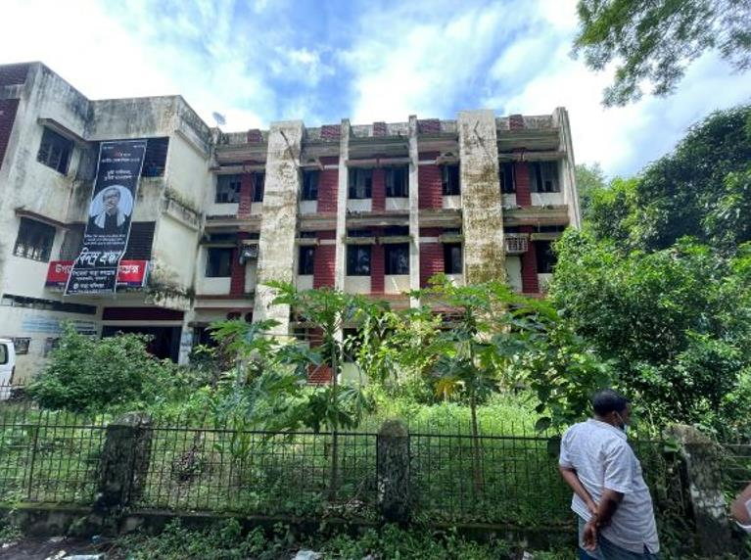
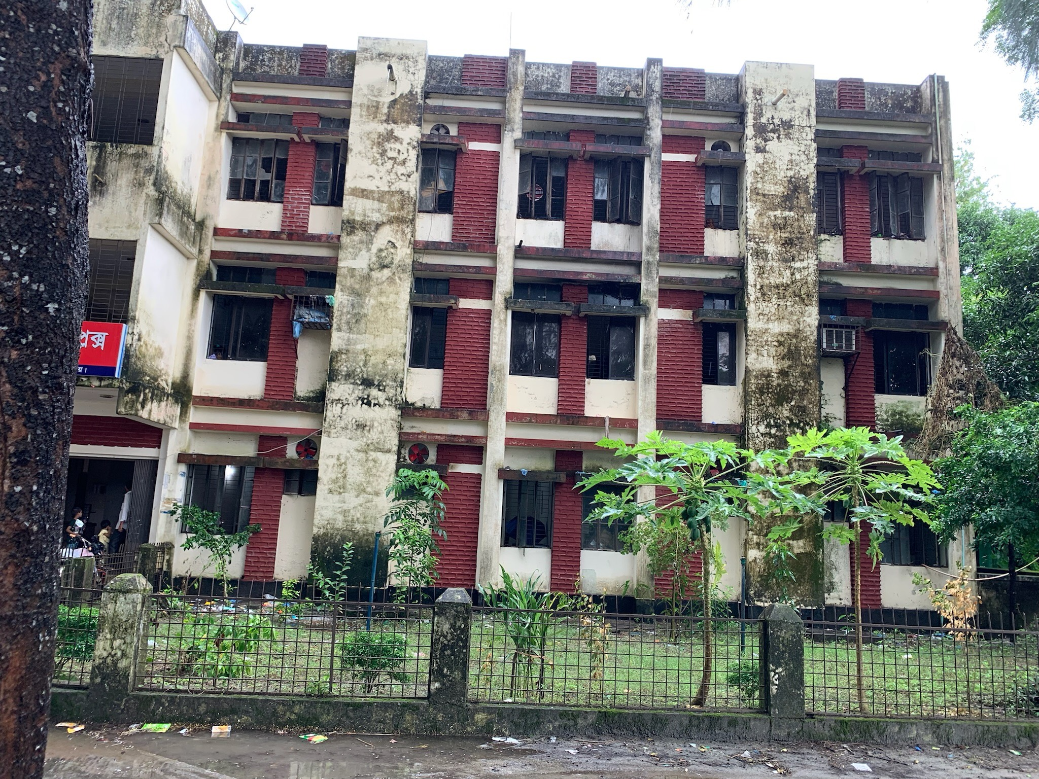
Changes in Gardens of The Hospital
Before
After

Slide 12
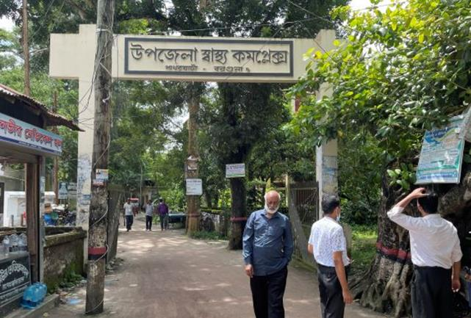
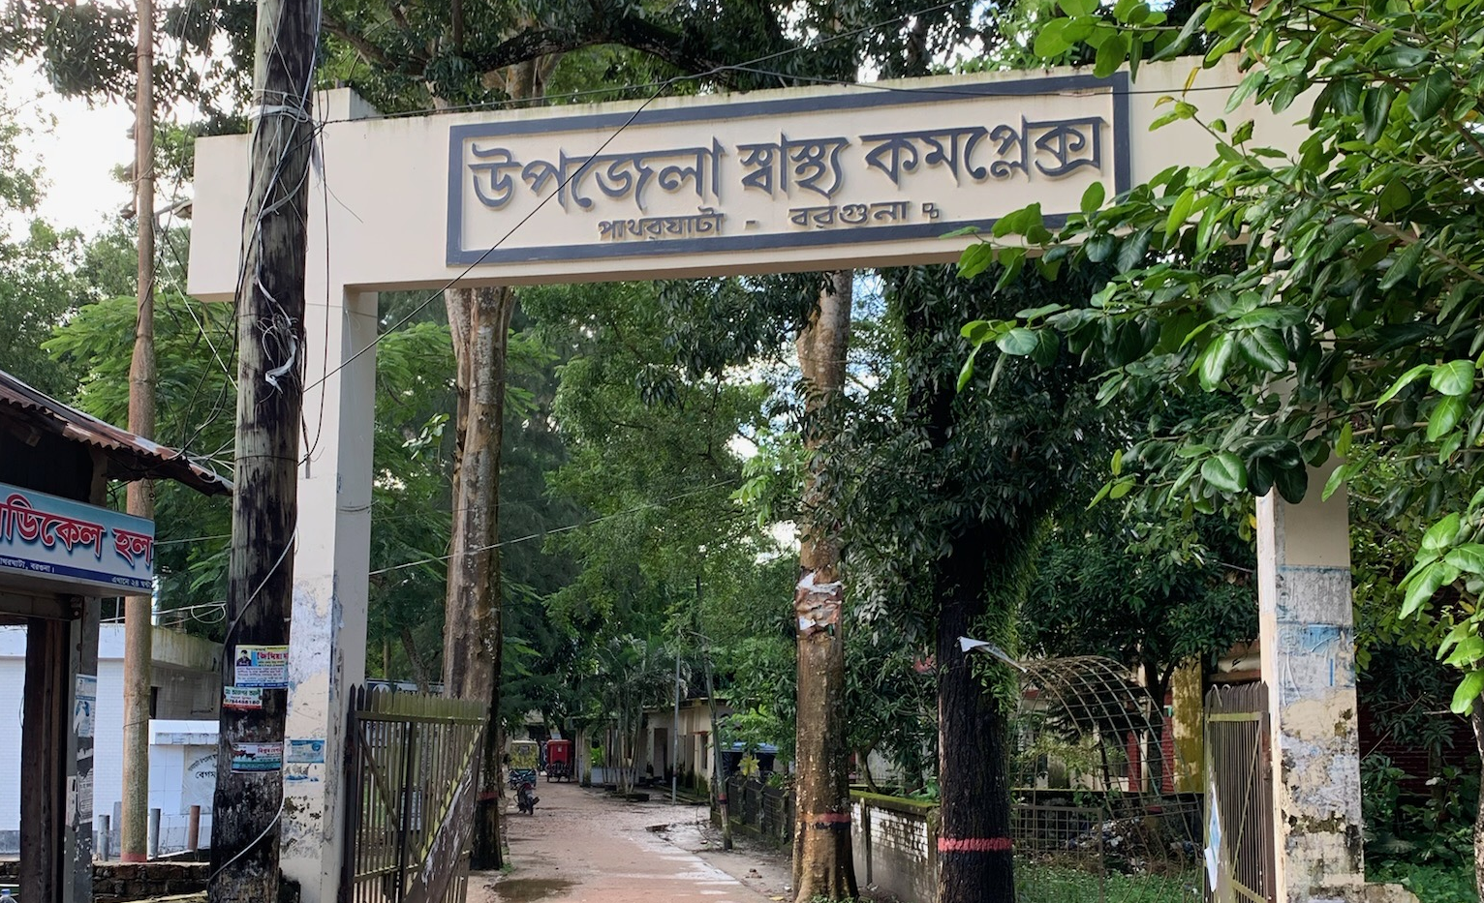
Changes around the Hospital Gate
Before
After

Slide 13
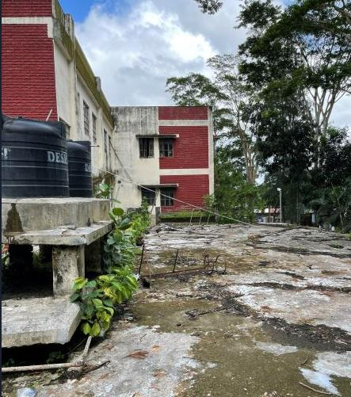
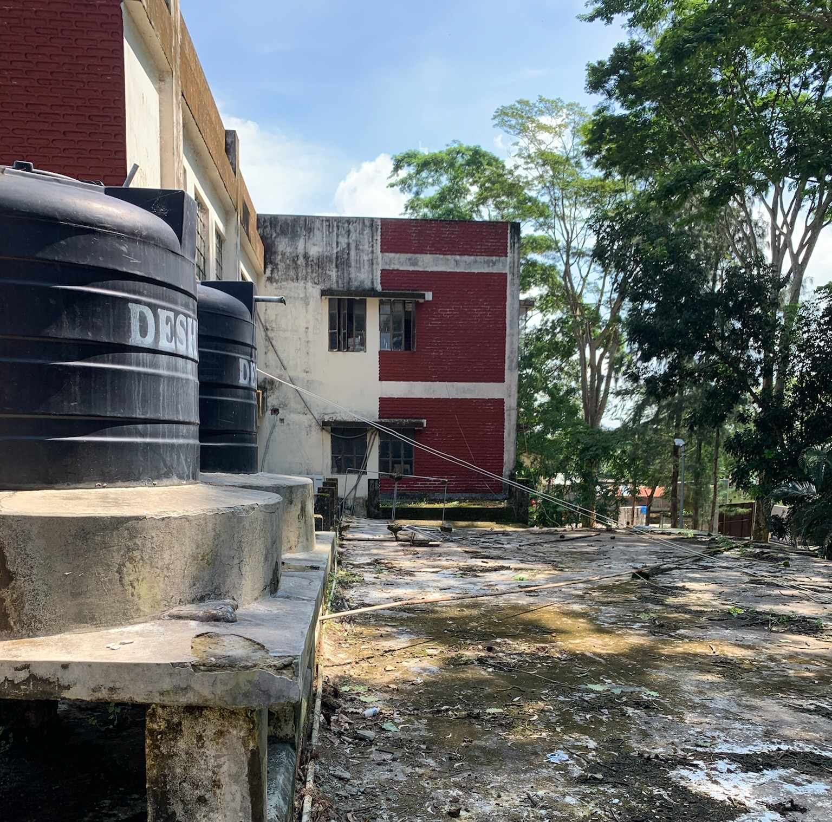
Changes in the Roof of the Hospital
Before
After

Slide 14
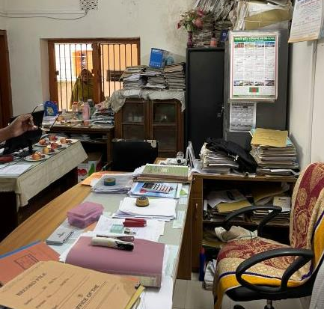
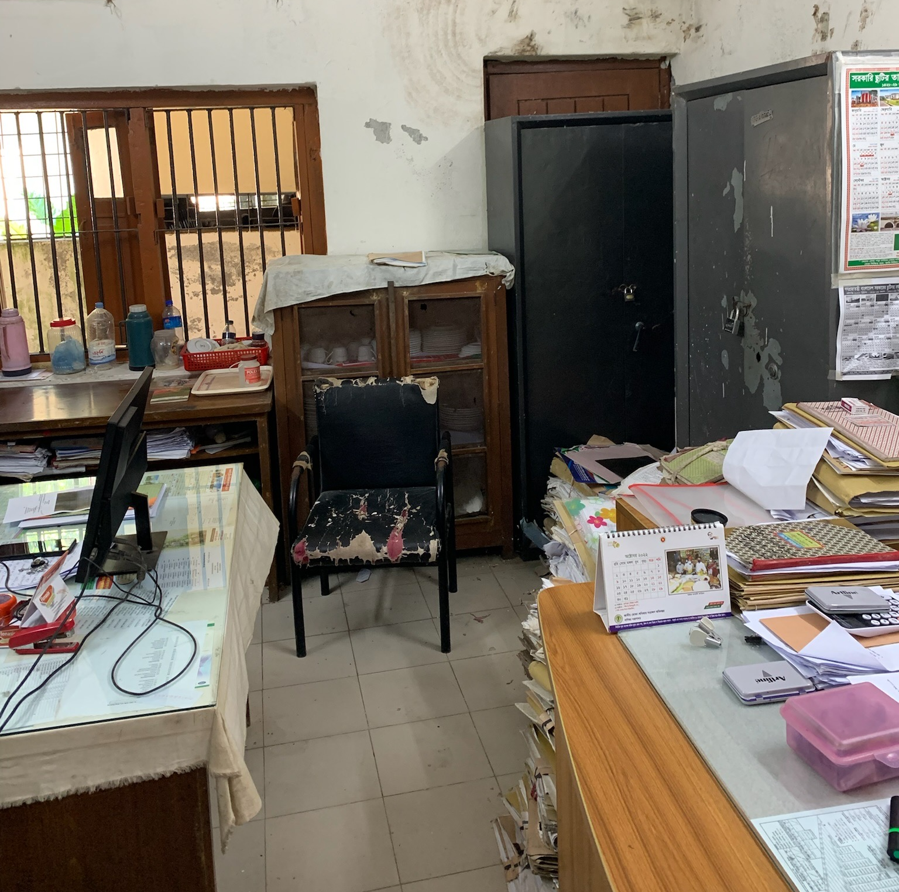
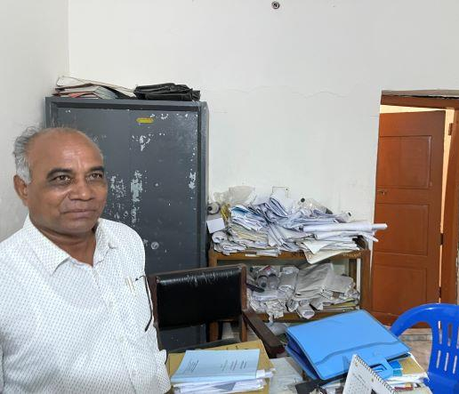
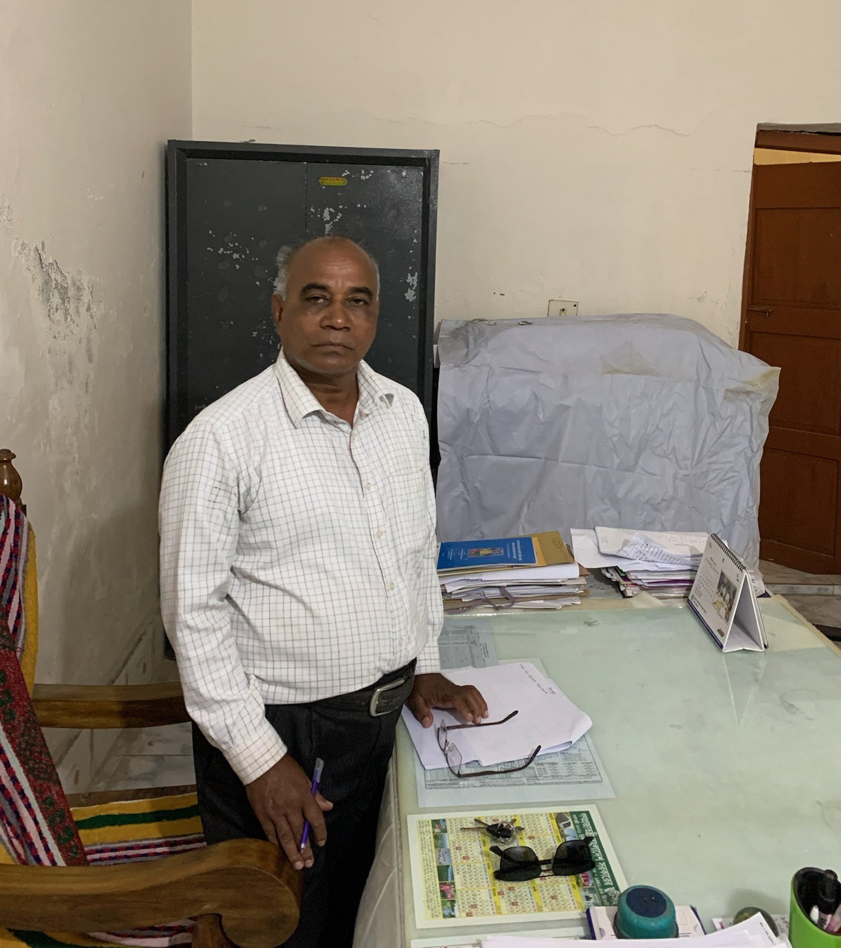
Changes in Office
Before
After
Before
After

Slide 15
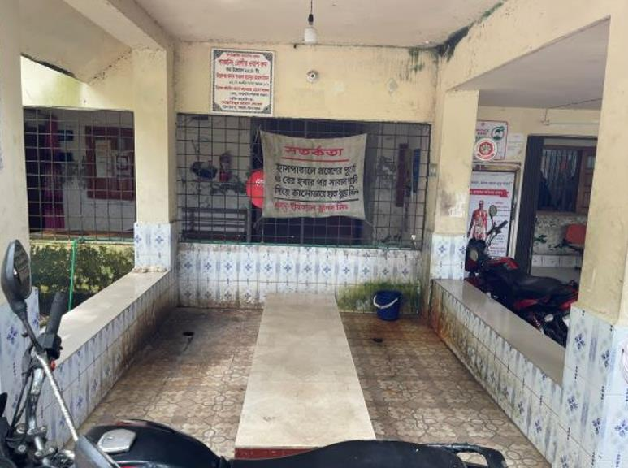
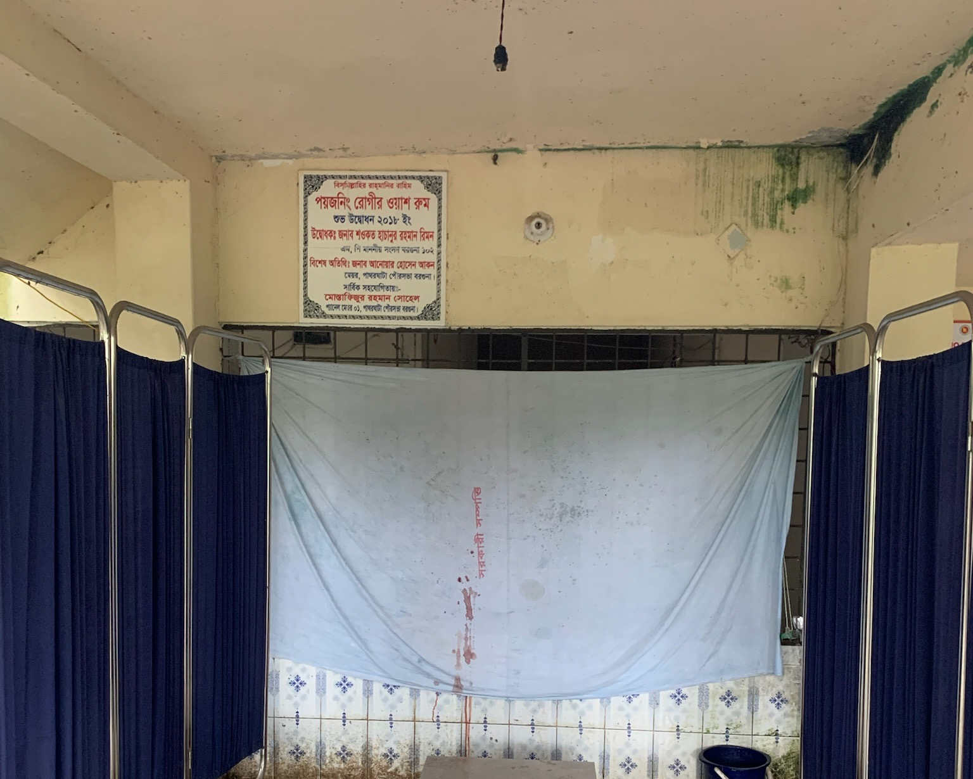
Changes in Poison washing area
Before
After

Slide 16
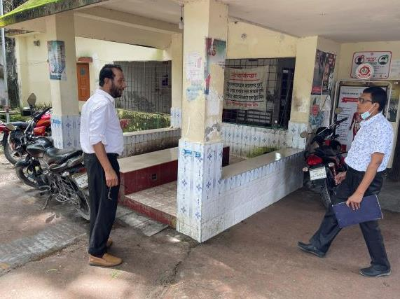
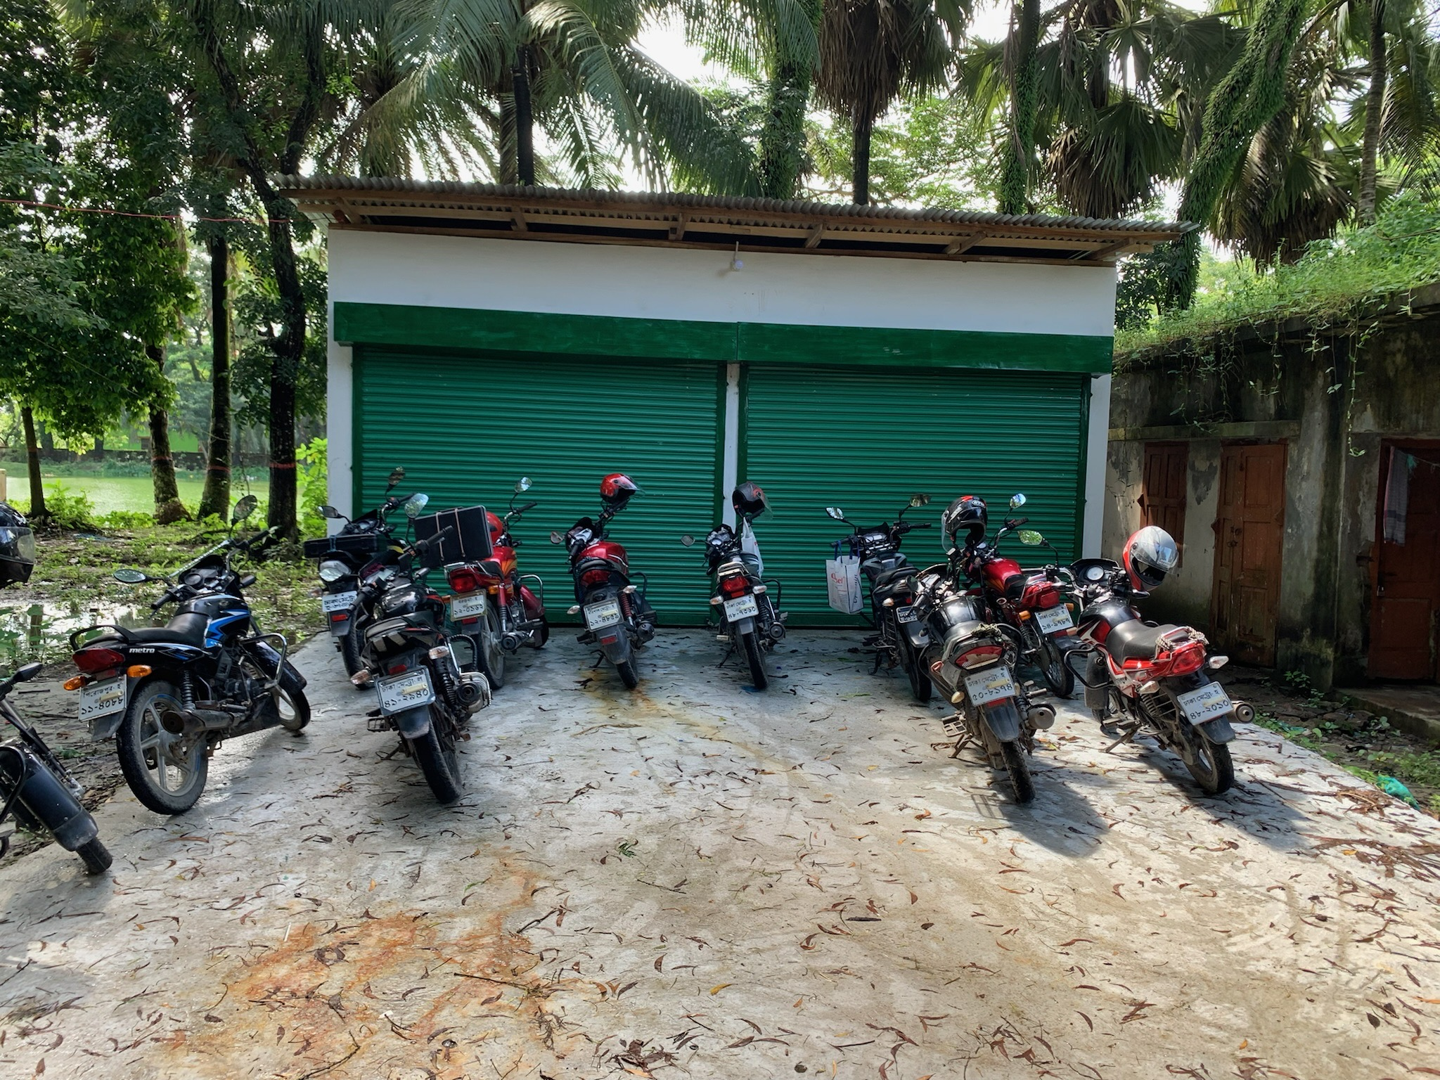
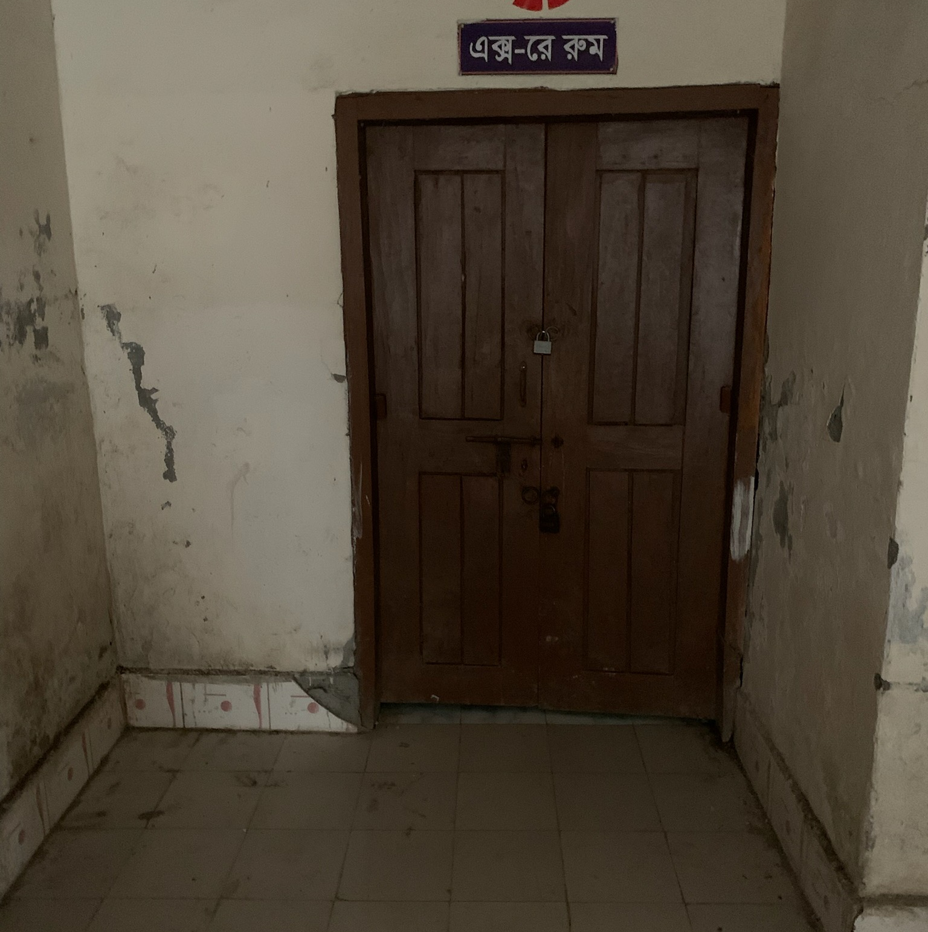
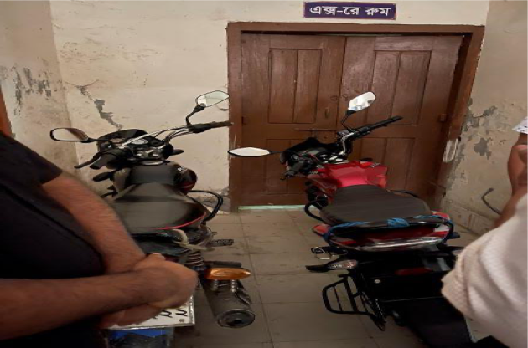
Changes in Motorcycle parking
Before
After
After
Before

Slide 17
Community Support in Ramgati UHC
For Example:
One IPS & delivery instruments financed by JICA for 10 delivery centres in each union.
Central oxygen system financed and organized by Upazila Parishad.
Blood donated by about 100 enlisted blood donors in emergency need (Transfusion of 165 bag F/blood are given in 2021, 2022)
Fuel of Generator donated by MP and Upazilla Parishad .

Slide 18
Achievements of the UHC
For Example:
Strong support from Upazilla Parisad for renovation of the UHC.
A Jeep was allocated for UH&FPO by Govt.
Our corona vaccine coverage- 1st dose-86.25% and 2nd dose-81.3%
EPI coverage-99.99%
Establishment of effective dental unit.
Establishment of NCD corner.

Slide 19
Challenges of the UHC
For Example:
Strong support from Upazilla Parisad for renovation of the UHC.
A Jeep was allocated for UH&FPO by Govt.
Our corona vaccine coverage- 1st dose-86.25% and 2nd dose-81.3%
EPI coverage-99.99%
Establishment of effective dental unit.
Establishment of NCD corner.

Slide 20
Way Forward….
For Example:
Starting of VIA activities to prevent cervical and breast cancer of female.
Starting of C-section for delivery mother
Functioning of X-ray facility.
Establishment of USG service.
Functioning of ECG service.
Implementation of effective SSK program.
Establish a cycle stand close to the main gate.

Slide 21
Thank You

